Slide 1
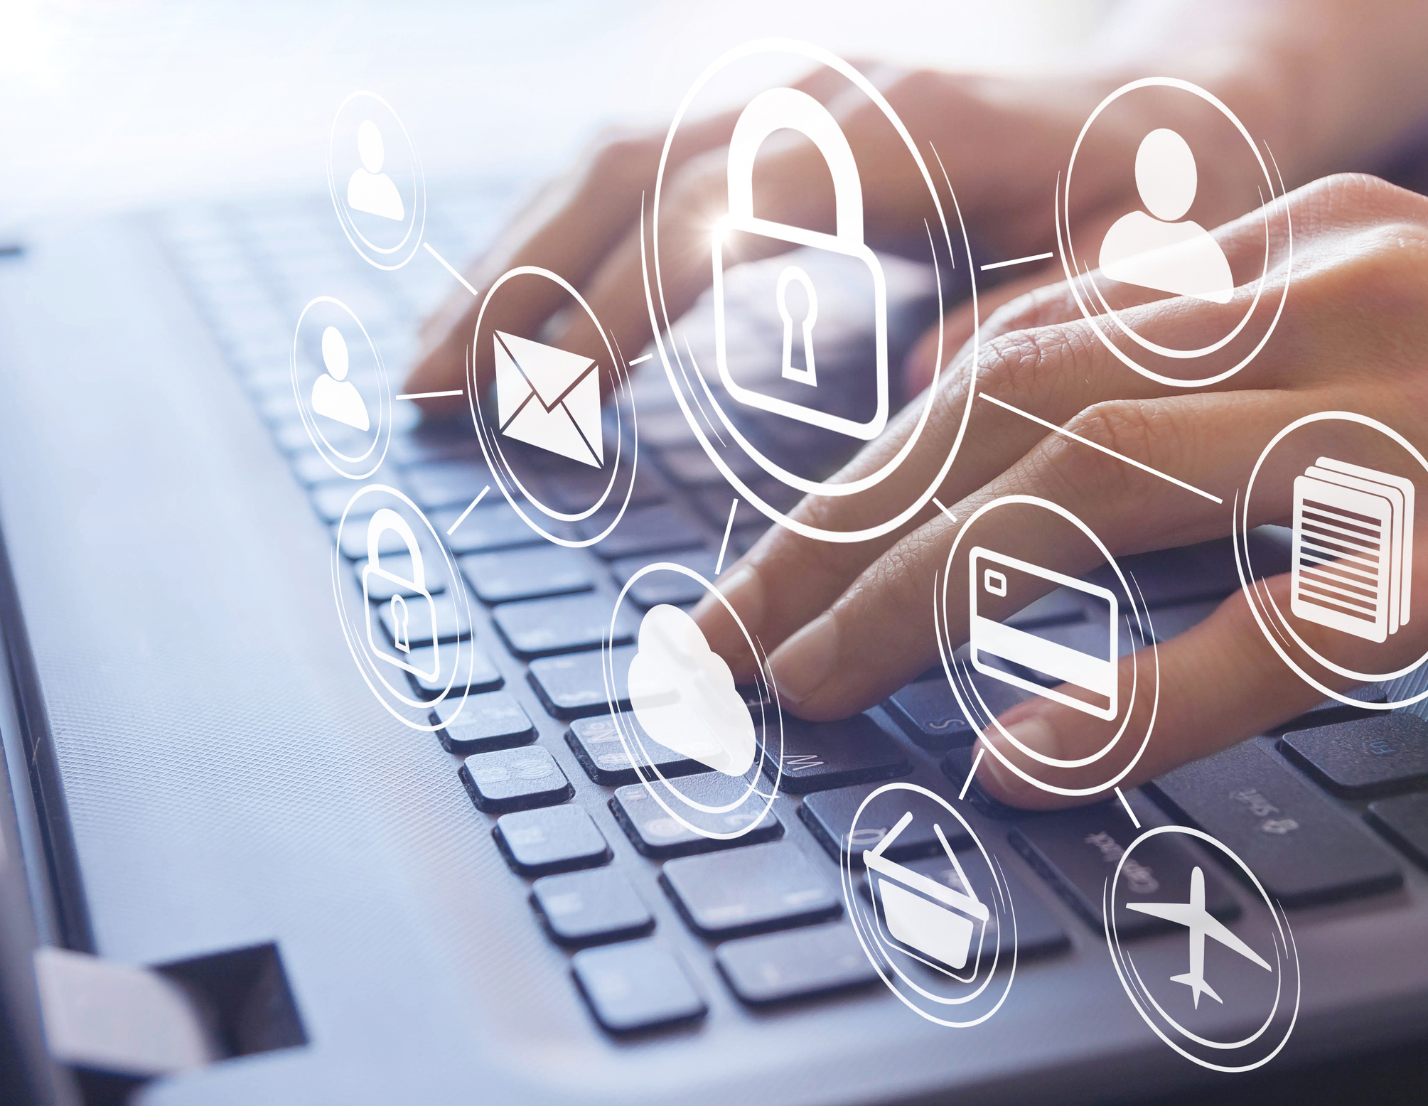

“Project-V”
Your Trusted Partner for Making Informed Decisions
01

Slide 2
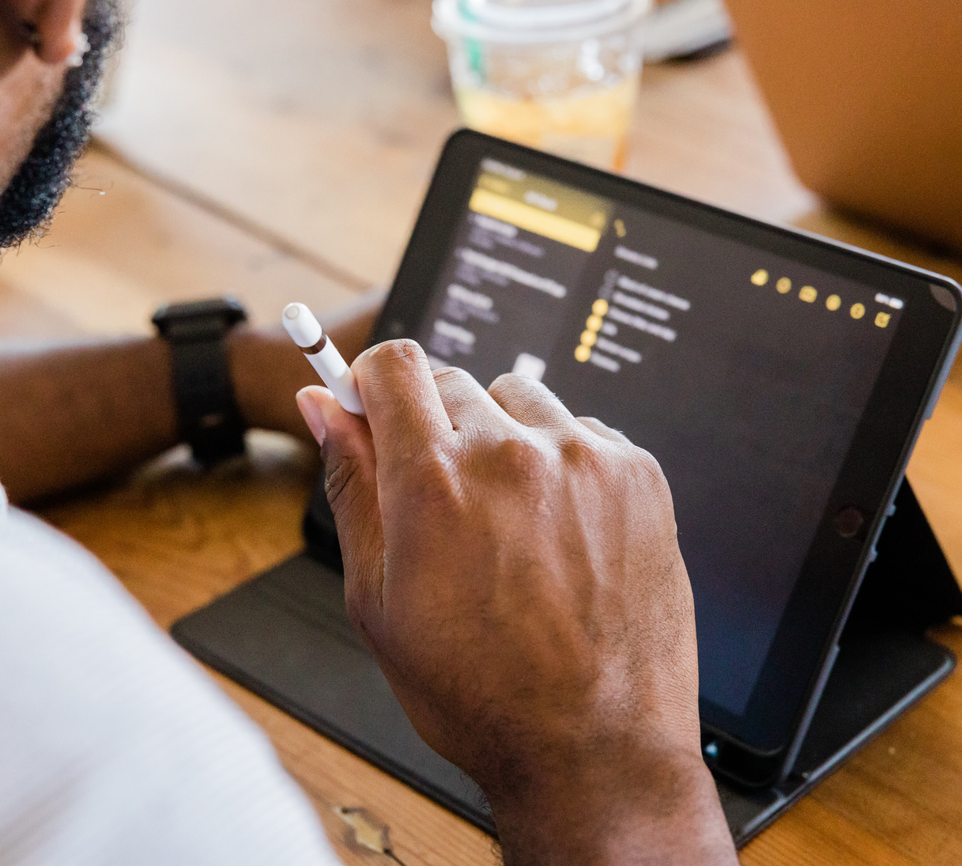
Project-V a cutting-edge platform designed to bridge the trust gap between startups, businesses, consumers, and governments globally.
Our Vision:
Empower individuals by providing a platform where you can verify the authenticity and trustworthiness of products, services, and events before you make decisions.
Our Mission:
Create a safer, more transparent world by reducing fraud, improving trust, and making informed choices accessible to everyone.
02

Slide 3
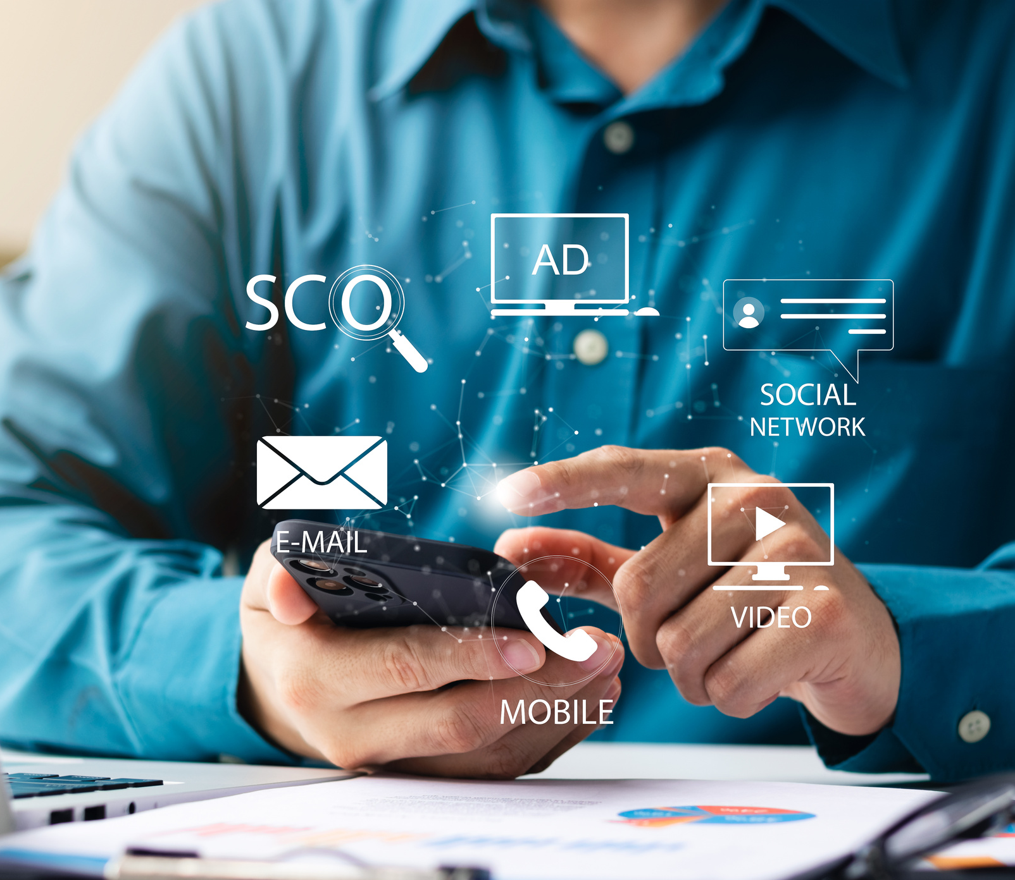
The Trust Problem in Today's World
Rising Fraud and Misrepresentation:
Consumers face growing challenges due to:
  Fake products or substandard services being sold online.
  Misleading advertising and scams across various industries.
Consequences for Citizens:
Financial Loss: Citizens are often duped into spending money on unreliable or fraudulent products/services.
Safety Risks: Lack of verification can lead to purchasing dangerous or faulty items, or attending unsafe events.
03

Slide 4
How Project-V (www.worldverified.org) Helps Citizens
project-V empowers you to make better, safer, and smarter decisions by verifying the authenticity of products, services, and events.
1. Verify Products and Services:
Ensure the authenticity of products you buy and the services you hire.
Real-time validation from verified sources, including feedback from other consumers.
2. Verify Events:
Know if an event you’re attending is legitimate and trustworthy before you invest time or money.
3. Avoid Fraud and Scams:
Get fraud detection alerts for any product or service that raises concerns about authenticity.
4. Public Feedback Integration:
Verified reviews and feedback from real customers help you make better decisions about products, services, and events.
04

Slide 5
Key Benefits for Citizens
1. Safe Shopping Experience:
  Never get scammed or misled again! Verify the authenticity of products and services before making a purchase.
  Avoid counterfeit goods that can be dangerous to your health and finances.
2. Informed Decisions on Services and Events:
  Know if a service or event is trustworthy, legitimate, and worth your time and money.
  Get recommendations for reliable businesses, reducing the risks associated with unverified providers.
3. Protect Your Financial Investments:
Avoid financial loss due to fraud, scams, or fake services by ensuring the authenticity of your purchases and investments.
4. Access Verified Feedback from Real Consumers:
See reviews and feedback from people who’ve actually used the product or service before, helping you make informed decisions.
05

Slide 6
How “Project-V” Works for You
1. Step 1: Verify Products and Services
  Simply search for the product or service you're interested in on www.worldverified.org
  Get verification from real customer feedback, expert reviews, and third-party authorities.
2. Step 2: Check Event Authenticity
Find and verify events (like concerts, conferences, workshops, etc.) to ensure they are legitimate and worth attending.
3. Step 3: Use Fraud Protection Tools
Be alerted to any red flags indicating fraudulent or misleading offers, saving you from making costly mistakes.
4. Step 4: Review Feedback
Browse through verified feedback and ratings from actual users to understand the quality of the product, service, or event before making a commitment.
06

Slide 7
The Power of Public Feedback & Transparency
Community-Driven Feedback:
All reviews and feedback on www.worldverified.org come from real consumers who have first-hand experience, ensuring reliability and authenticity.
Transparency in the Market:
Verified reviews ensure that you have access to unbiased, transparent information about products, services, and events.
07

Slide 8
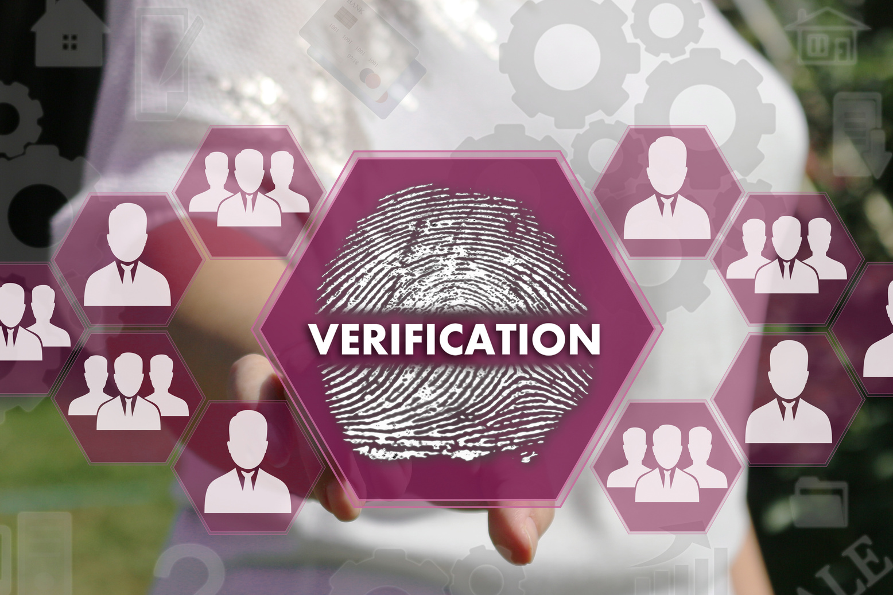

Why Should You Trust www.worldverified.org?
1. Accurate and Verified Information:
We only provide verified data from trusted sources, including user feedback, business credentials, and expert reviews.
2. Real-Time Updates:
Stay up to date with real-time information about products, services, and events to avoid outdated or misleading claims.
3. Global Trust Network:
www.worldverified.org works globally to ensure the authenticity of businesses, products, and services, giving you a worldwide resource to make safe decisions.
4. Community and Expert-Driven Verification:
Each product, service, or event is validated by a combination of community feedback and expert analysis, ensuring you’re getting the most accurate, up-to-date information.
08

Slide 9
WHY SHOULD YOU USE WWW.WORLDVERIFIED.ORG?
1. Say Goodbye to Scams:
Verify products and services before you buy or invest.
2. Make Safer Choices:
Always choose verified, trustworthy options with confidence.
3. Empower Yourself with Information:
Take control of your decisions by accessing a global network of verified feedback.
4. Join the Trusted Community:
Become part of a global community of users who are making safe, informed decisions every day.
09

Slide 10

Don’t take risks with your time and money.
Start verifying your purchases, services, and events on www.worldverified.org today!
For inquiries, contact us:
Email:
communications@worldverified.org
team.worldverified@gmail.com
Scan QR:
WhatsApp us:
+91-73865 74116

